Slide 1
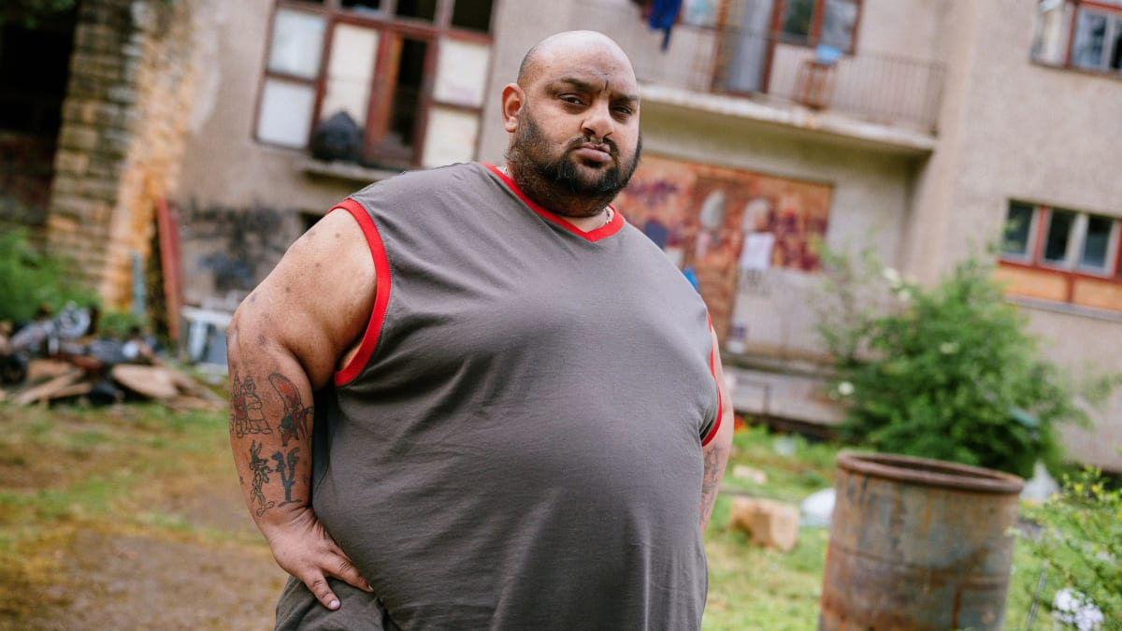
Na plech
Patrik Schneider
I2.C

Slide 2
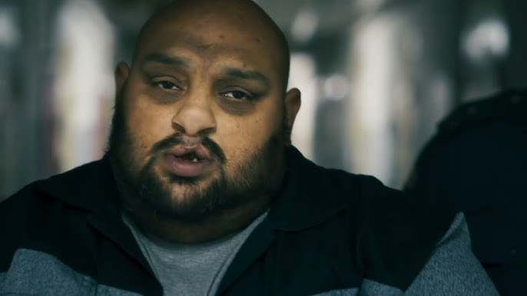
Introduction
Genre: Comedy
Director: Marty Pohl
Release date: 23th of January, 2025
Notes:
"Na plech" is a 2025 Czech comedy film directed by Marty Pohl, who is also known as the rapper Řezník. The film was released on January 23, 2025, in the Czech Republic.

Slide 3
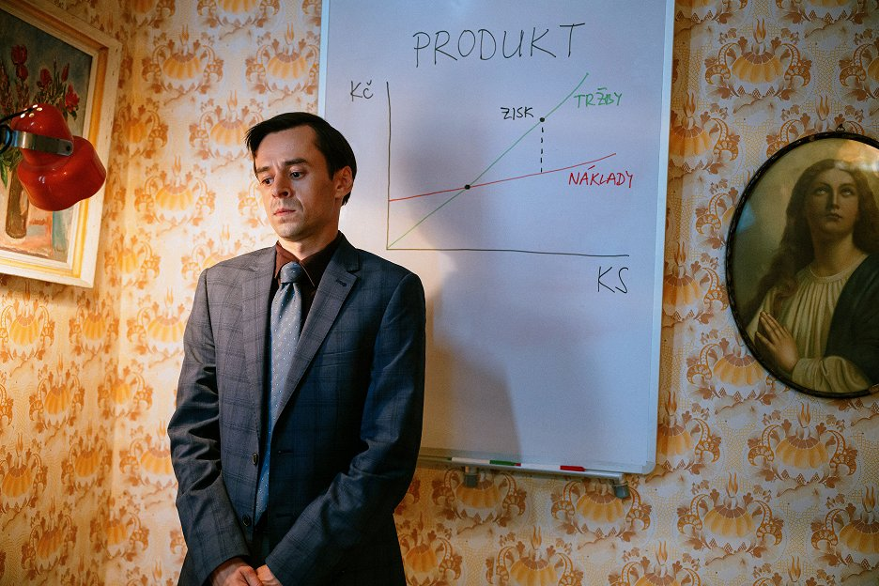
Main Character
Protagonist: Marek
Young economist
Moves to northern Czechia for a new job
Gets involved with and unusual family
Notes:
Marek, a young economist, relocates to northern Czechia for work. Unexpectedly, he becomes entangled with a peculiar family living nearby.

Slide 4
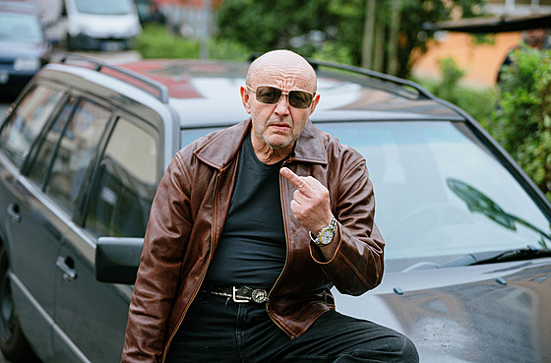
The plot
Marek finds a lost backpack and tries to return it
He is detained by a police inspector and forced to cooperate
He infiltrates a family that produces methamphetamine
Uses his economic knowledge to improve their business
Notes:
Marek discovers a lost backpack and attempts to return it, but a police inspector detains him and convinces him to collaborate. He infiltrates a family involved in meth production and uses his economic skills to improve their operations.

Slide 5
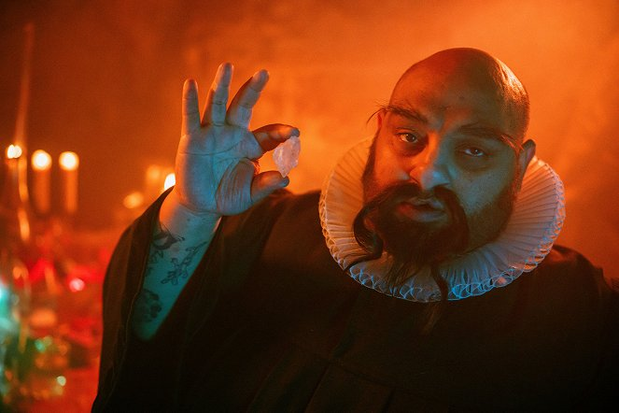
Themes and style
Part of the ZNK (Život není krásný) universe.
Features absurd humor and satire
Notes:
The film blends street smarts with economic tactics, delving into themes like family and friendship. It showcases absurd humor and satire, aligning with the ZNK universe created by Marty Pohl.

Slide 6

Thank you for your attention

